Slide 1
GitHub

Slide 2
There is a lot of learning material and YouTube videos online.
However, almost all of the introductory material is either very long winded, too technical, or too broad. I’ve tried to make it so that everything you will need to know is squashed in one place: here. But I would encourage to read around.

Slide 3
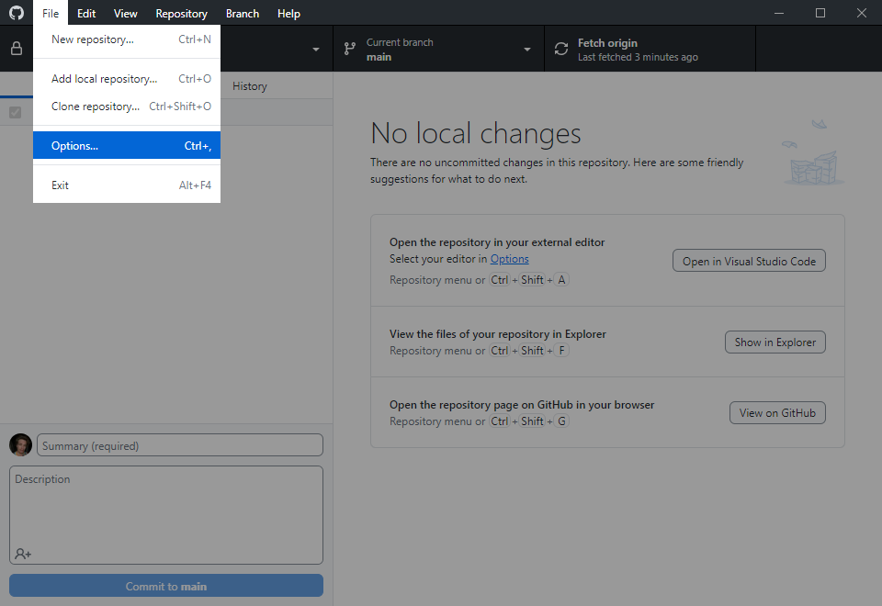
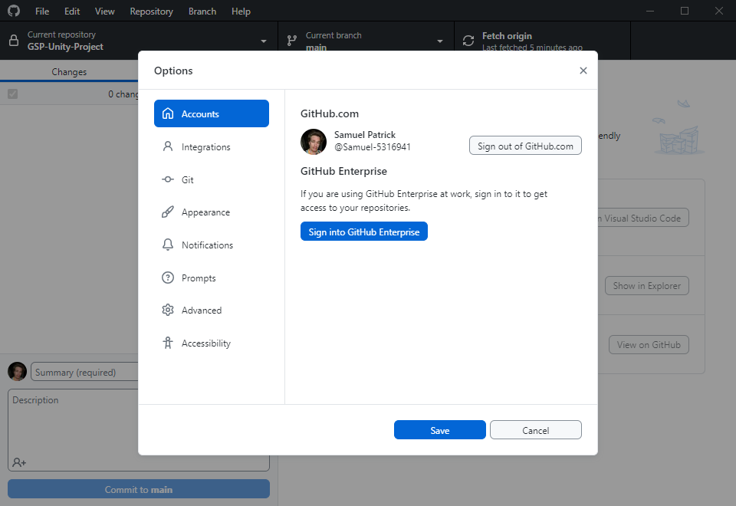
SIGN IN
Go to File > Options
Ensure you are signed in
Review software specification versions on Discord (for all software)

Slide 4
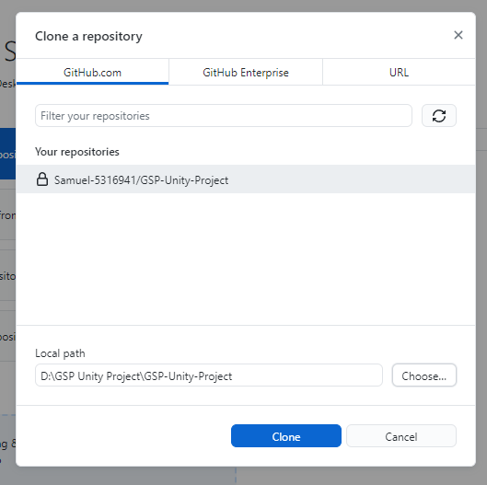
CLONE THE REPOSITORY
This section is duplicated from the on-boarding; skip if you’ve already done it.
Go to File > Clone Repository … and then you should see our repo, “GSP-Unity-Project”. Select that one.
You should clone the repository somewhere out of the scope of any other version control or cloud storage (OneDrive, Google Drive, Dropbox etc). If possible, use the C: drive or D: drive or similar. Directly on the drive you can create a folder called “Git Repositories”.
You should have something like this (and if so, you can Clone)

Slide 5
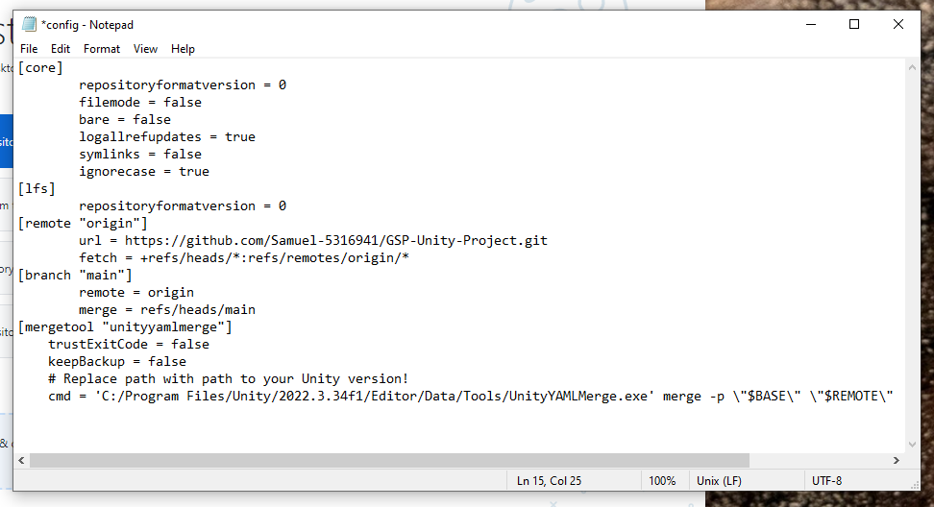
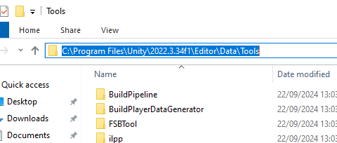
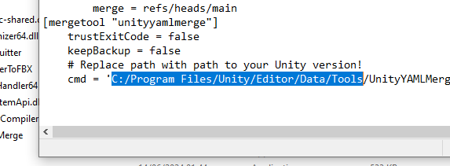
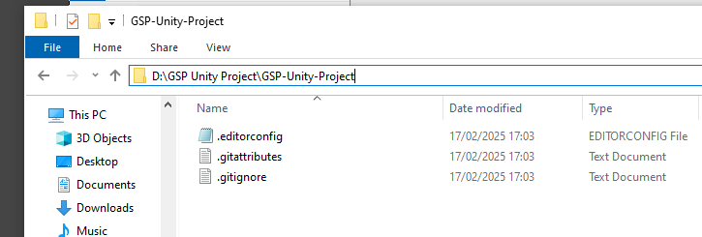
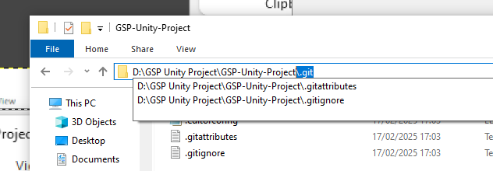
CONFIGURE UNITY YAML MERGE
This must be done every time you clone the GSP-Unity-Project repository (for instance, if you clone in the Labs, you should configure it even if you did it on your local machine).
Navigate to the repo you just cloned. Go to the folder file path, and type the highlighted below onto the end:
This should open up a hidden folder. Open the file “config” in a text editor (right click, Open with…, scroll to Notepad).
Copy this text and paste it in the “config” file. You should have something like this:
Navigate to your Unity installation. You’re looking for the UnityYAMLMerge.exe. It should be somewhere around here, in the Tools folder:
Copy the file path (you’ll have to Ctrl+C). Go to the “config” file in the text editor. Highlight the below path exactly and paste over it exactly with your own path.
[mergetool "unityyamlmerge"]
trustExitCode = false
keepBackup = false
# Replace path with path to your Unity version!
cmd = 'C:/Program Files/Unity/Editor/Data/Tools/UnityYAMLMerge.exe' merge -p \"$BASE\" \"$REMOTE\" \"$LOCAL\" \"$MERGED\"

Slide 6
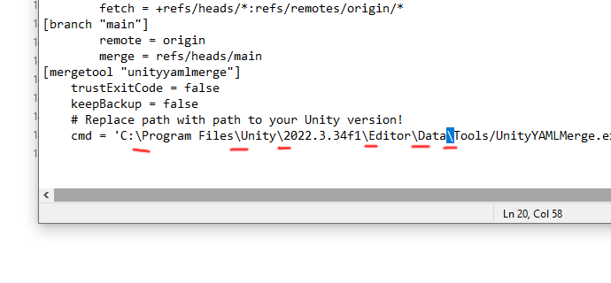
CONFIGURE UNITY YAML MERGE (cont)
You must replace the back-slashes in the text you pasted (from “C:” to “Tools”) with forward-slashes again. Ignore the back-slashes later in this line after the “-p”, they are supposed to be this way. Save the file.
[mergetool "unityyamlmerge"]
trustExitCode = false
keepBackup = false
# Replace path with path to your Unity version!
cmd = 'C:/Program Files/Unity/Editor/Data/Tools/UnityYAMLMerge.exe' merge -p \"$BASE\" \"$REMOTE\" \"$LOCAL\" \"$MERGED\"

Slide 7
REMOVING THE REPO(S) (LABS ONLY)
When you are finished working in the Labs, make sure your changes are committed and pushed.
If you unsure you are pushed, you can check on the GitHub website and look at the repo if you are unsure before you delete the repo from the Lab PC.
Go to Repository > Remove… in GitHub Desktop, then select our repo(s), and remove them, and please tick the box that says “Send to Recycle Bin”).
Any unpushed changes, even committed ones, will be gone forever when you delete a local repository.

Slide 8
Pushing Changes

Slide 9
Hopefully by now you understand the principles that a repository exists remotely and can be cloned on a local machine, and that from there you can make changes and update the remote repository.
Remote Repository
Clone repository
Local Repository
Push changes

Slide 10
However, there are more steps involved in pushing changes to a remote repository.
Local
?
?
Push
Remote

Slide 11
Changes that are made locally have to be committed. Commits are supposed to represent some kind of “finished step” in your work. A commit therefore represents a snapshot in history of your file(s). You can make as few or as many commits as you need before you push those changes.
When you push, your commit history is also pushed, so in the remote repository you have made available your latest changes as well as a record of all the other commits you made.
Remote Repository
Remote Repository
Commit changes
Working Directory
Local Repository
Push your commits

Slide 12


Commits you make are local. They won’t be available on the remote repository unless you push them.
You do not have to push commits until you are ready and tested. That might take several days and several computer restarts. That’s okay. GitHub Desktop will store your commit history locally for as long as it takes until you’re ready to push your changes.
Remote Repository
Remote Repository
commit
commit
commit
commit
a
b
c
d
e
b
c
d
e
push
Local Repository
Local Repository
Local Repository
Local Repository
Local Repository
If at this point someone else clones the repo, they won’t get your commits.
Local Repository
clone
Oldest commit history
Latest commit history

Slide 13
What is in a commit? Why commit things in steps? Why not just commit everything all at once and push at the end of the working day?
Commit ID
History/changes
Commit summary
Timestamp
Author
The only thing you’ll have to specify is a summary. There is a lot of dogma about how to write the summary. Most developers will stick to something that is simple, explanatory, and present tense.
Summary example: Update table prop
Guilty of thing_final_final_draftv25?
What your workflow tells you is that you would benefit from Git commits.
If you commit all in one go, all those steps you took to get there are squashed into one commit. What if you want to go back to
thing_final_final_draftv23?
If you make sensible, regular commits, you can roll back to an earlier working version. Rolling back will revert your working directory to exactly how it was in the last commit.
If you mess something up, you can roll back one, some or even all of your commits since your last push. Imagine one little thing went terribly wrong and you had to undo all your work since the last push. If you have multiple commits, then you lose minimal work.

Slide 14
Now you know about commits, there is one last step to know.
Local
?
Commit
Push
Remote

Slide 15
A
B
C
Remote Repository
Let’s say after you cloned the repo, you made some changes:
you deleted file A
you edited file B
you created file C
GitHub Desktop will record your changes in the staging area.
Let’s rewind to when you finished your work and everything was in the staging area.
One answer is to work on one file/issue per commit, but this does not always reflect the reality of editing. Instead, you can unstage anything you don’t want to commit for now. Then, you can commit one “chunk” at a time.
At this stage, if you make a commit, GitHub will take everything in the staging area and package it in one commit.
Remote Repository
But what about accurate naming? What if you deleted an old file, fixed a bug, and created a new prop? Let’s say you made 100 edits over those three files and committed them at once. That’s messy to unpick if something is wrong with only one file but you want to keep the changes you made to the other two.
A
B
GitHub Desktop
automatically staging changes
GitHub Desktop
checks what files are staged when you create a commit
Clone repo
Making changes
Latest pushed commit(s)
Commit changes
Working
Directory
Staging
Area
Local Repository Commits
Remote Repository Commit History
Push your commits
A
File A deleted!
A
A
A
B
B
C
B
File B edited!
C
File C created!
Staging area
automatically clears
Commit(s)
ready to push
Previous pushed commit(s)

Slide 16
A
B
C
Remote Repository
Let’s say after you cloned the repo, you made some changes:
you deleted file A
you edited file B
you created file C
GitHub Desktop will record your changes in the staging area.
Let’s rewind to when you finished your work and everything was in the staging area.
One answer is to work on one file/issue per commit, but this does not always reflect the reality of editing. Instead, you can unstage anything you don’t want to commit for now. Then, you can commit one “chunk” at a time.
Replay this slide a few times, watch the icons, read the text
Remote Repository
GitHub Desktop
automatically staging changes
GitHub Desktop
checks what files are staged when you create a commit
Clone repo
Making changes
A
You make
a commit (notice only file B changed, and A is gone because it was deleted) Don’t forget, each commit’s changes
are compared to the previous commit, or if there isn’t a local commit currently, then the latest commit on the remote repo
B
Files committed are cleared
from staging area
(because there is now no
difference in local file
and latest local commit) if they are edited again,
they’ll get automatically staged again
You make
a commit (notice only file A changed) Don’t forget, this commit is
comparing changes against
the latest commit in the repo!
Latest pushed commit(s)
You make
a commit (notice only file C changed)
You choose what changes are staged
Commit changes
Working Directory
Staging
Area
Local Repository Commits
Remote Repository Commit History
Push your commits
File A deleted!
A
B
B
A
File B edited!
File B edited!
B
C
B
File C created!
File C created!
C
Previous pushed commit(s)

Slide 17
Let’s say after you cloned the repo, you made some changes:
you deleted file A
you edited file B
you created file C
GitHub Desktop will record your changes in the staging area.
Now, when you push, the repo’s latest commit is stuffed into the history, your previous commits are stacked on top, and then your latest commit is now the repo’s latest commit.
Then, your local repo and the remote repo are matching again, GitHub Desktop will have an empty staging area, and your local commits will be now part of the remote commit history, as are everyone else’s.
Remote Repository
A
B
B
C
B
C
Latest pushed commit(s)
Working Directory
Staging
Area
Local Repository Commits
Remote Repository Commit History
A
A
B
B
A
B
B
C
B
B
B
C
Previous pushed commit(s)

Slide 18
You’ve hopped about across a few different files …
edit
edits
Commit: Update table prop
edit
5.05pm
2pm
edit
edits
Commit: Fix bugs in plant prop
edit
5.07pm
edit
edits
edit
Commit: Create window prop
5.08pm
edit
4pm
edit
Staging only some files and committing them before staging files from an unrelated task and committing those, straightens out your edit history into neat commits. If you don’t fold your laundry and put it in the correct drawers, you have to root out your entire closet for a single thing when you really need it fast, and you’ll mess up your room in the process.
edit

Slide 19
Probably too often
Goldilocks
Probably too little
Commit: Edit texture for table prop
Commit: Update table prop
Commit: Everything I did today
(Let’s say you made 2 edits)
(Let’s say you made 12 edits)
(Let’s say you made 329 edits)
Commit: Edit UV for table prop
Commit: Fix bug in plant prop
(You made 1 edit)
(Let’s say you made 4 edits)
Commit: Fix topology for table prop
Commit: Create window prop
(2 edits)
(Let’s say you made 19 edits)
Commit: Edit texture for table prop
(1 edit)
Commit: Edit texture for table prop
(1 edit)
So how often should you make a commit?
Ultimately it is somewhat up to you, but your commit history needs to be understandable to yourself and others all the way back to the beginning. Committing every tiny little edit you make is too granular to be meaningful, and committing everything all at once can make extremely hard to find the origin of bugs or problems.
Commit: Fix UV for table prop
(1 edit)

Slide 20
This looks complicated, but once you’ve done it a few times, it’s pretty simple. GitHub Desktop encapsulates nearly all of this functionality for you, and it’s a case of pressing a few buttons. For most of the time, this is all any of us will need to do with Git and GitHub.

Slide 21
Now you know about the staging area.
You hopefully also understand that these steps are more of a continual cycle until you’re ready to push your work: local edits, staging, committing.
Local
Stage
Commit
Push
Remote

